Slide 1
Design Patterns II
Yuqun Zhang
CS304
Figures from Head First Design Patterns

Slide 2
The Observer Pattern

Slide 3
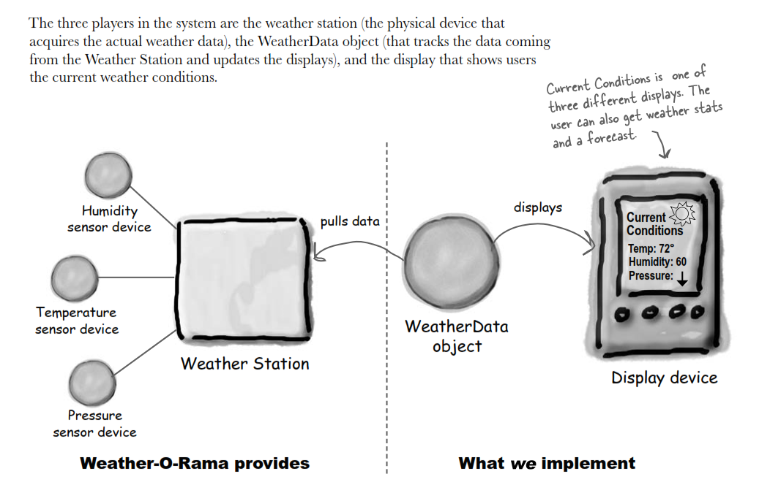
A Weather Monitoring Application
Create an app that uses the WeatherData object to update three different displays:
“current conditions”
“weather stats”
“forecast”

Slide 4
What Needs to be Done?
WeatherData
getTemperature()
getHumidity()
getPressure()
measurementsChanged()
/*
* Call this method
* whenever measurements are
* Updated
*/
public void measurementsChanged(){
// your code goes here
}
Update three
different displays

Slide 5
Problem Specification
The WeatherData class has getters and setters for temperature, humidity, and pressure
The measurementsChanged() method is called anytime new weather data is available
We don’t know or care how.
We need to implement three different display elements that use the weather data
The system must be expandable, in case others want to add other display elements later

Slide 6
A First Try
public class WeatherData {
//instance variable declarations
public void measurementsChanged(){
float temp = getTemperature();
float humidity = getHumidity();
float pressure = getPressure();
currentConditionsDisplay.update(temp, humidity, pressure);
statisticsDisplay.update(temp, humidity, pressure);
forecastDisplay.update(temp, humidity, pressure);
}
// other methods
}
What’s Wrong?

Slide 7
A First Try
public class WeatherData {
//instance variable declarations
public void measurementsChanged(){
float temp = getTemperature();
float humidity = getHumidity();
float pressure = getPressure();
currentConditionsDisplay.update(temp, humidity, pressure);
statisticsDisplay.update(temp, humidity, pressure);
forecastDisplay.update(temp, humidity, pressure);
}
// other methods
}
Not so bad: here’s a common interface!
Coding to implementations: adding displays requires changing the program
Encapsulate stuff that changes!
What’s Wrong?

Slide 8
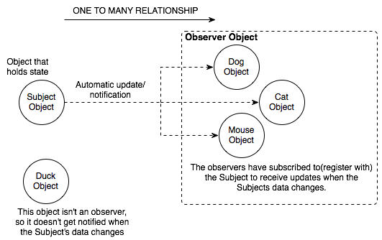
Publish/Subscribe
Just like newspapers and magazines
You subscribe and receive any new additions
You unsubscribe and stop receiving anything

Slide 9
The Observer Pattern
The Observer Pattern defines a one-to-many dependency between objects so that when one object changes state, all its dependences are notified and updated automatically.

Slide 10
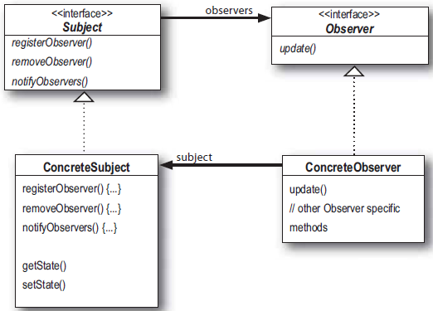
The Observer Pattern

Slide 11
The Observer Pattern
Objects use the Subject interface to (de)register as observers

Slide 12
The Observer Pattern
Objects use the Subject interface to (de)register as observers
Each subject can have many observers

Slide 13
The Observer Pattern
All potential observers need to implement the Observer interface and provide the update() method
Objects use the Subject interface to (de)register as observers
Each subject can have many observers

Slide 14
The Observer Pattern
All potential observers need to implement the Observer interface and provide the update() method
Objects use the Subject interface to (de)register as observers
Each subject can have many observers
A concrete subject always implements the Subject interface and the notifyObservers() method

Slide 15
The Observer Pattern
All potential observers need to implement the Observer interface and provide the update() method
Objects use the Subject interface to (de)register as observers
Each subject can have many observers
Concrete observers can be any class that implements the Observer interface and registers with a concrete subject
A concrete subject always implements the Subject interface and the notifyObservers() method

Slide 16
The Power of Loose Coupling
The only thing a subject knows about an observer is that it implements a given interface
We can add new observers at any time
We never need to modify the subject to add new types of observers
We can reuse subjects or observers independently of each other
Changes to either the subject or an observer will not affect each other

Slide 17
The Power of Loose Coupling
The only thing a subject knows about an observer is that it implements a given interface
We can add new observers at any time
We never need to modify the subject to add new types of observers
We can reuse subjects or observers independently of each other
Changes to either the subject or an observer will not affect each other

Slide 18
The Power of Loose Coupling
The only thing a subject knows about an observer is that it implements a given interface
We can add new observers at any time
We never need to modify the subject to add new types of observers
We can reuse subjects or observers independently of each other
Changes to either the subject or an observer will not affect each other
Loosely coupled designs allow us to build flexible OO systems that can handle change because they minimize the interdependencies between objects.

Slide 19
Exercise
Draw the class diagram for the weather data app

Slide 20
Weather Data Interfaces
public interface Subject {
public void registerObserver(Observer o);
public void removeObserver(Observer o);
public void notifyObservers();
}
public interface Observer {
public void update(float temp, float humidity, float pressure);
}
public interface DisplayElement {
public void display();
}
Notes:
What’s wrong with the signature of the update method? Think about change…

Slide 21
Weather Data Interfaces
These first two methods take an Observer as an argument
public interface Subject {
public void registerObserver(Observer o);
public void removeObserver(Observer o);
public void notifyObservers();
}
public interface Observer {
public void update(float temp, float humidity, float pressure);
}
public interface DisplayElement {
public void display();
}
This method is called to notify all observers when the Subject’s state has changed
The Observer interface is implemented by all observers, giving them the update() method
We added in a DisplayElement interface since all of the display types share the need to display()
Notes:
What’s wrong with the signature of the update method? Think about change…

Slide 22
Implementing the Subject Interface
public class WeatherData implements Subject {
private ArrayList observers;
private float temperature;
private float humidity;
private float pressure;
public WeatherData() {
observers = new ArrayList();
}
public void registerObserver(Observer o) {
observers.add(o);
}
public void removeObserver(Observer o) {
int i = observers.indexOf(o);
if (i >= 0) {
observers.remove(i);
}
}

Slide 23
Implementing the Subject Interface
public class WeatherData implements Subject {
private ArrayList observers;
private float temperature;
private float humidity;
private float pressure;
public WeatherData() {
observers = new ArrayList();
}
public void registerObserver(Observer o) {
observers.add(o);
}
public void removeObserver(Observer o) {
int i = observers.indexOf(o);
if (i >= 0) {
observers.remove(i);
}
}
This ArrayList holds our observers, and we’ll have to maintain it…
These methods were required by the Subject interface.

Slide 24
Notify Methods
public void notifyObservers() {
for (int i = 0; i < observers.size(); i++) {
Observer observer = (Observer)observers.get(i);
observer.update(temperature, humidity, pressure);
}
}
public void measurementsChanged() {
notifyObservers();
}
public void setMeasurements(float temperature, float humidity, float pressure){
this.temperature = tempreature;
this.humidity = humidity;
this.pressure = pressure;
meassurementChanged();
}

Slide 25
Notify Methods
public void notifyObservers() {
for (int i = 0; i < observers.size(); i++) {
Observer observer = (Observer)observers.get(i);
observer.update(temperature, humidity, pressure);
}
}
public void measurementsChanged() {
notifyObservers();
}
public void setMeasurements(float temperature, float humidity, float pressure){
this.temperature = tempreature;
this.humidity = humidity;
this.pressure = pressure;
meassurementChanged();
}
This one was required by the Subject interface, too.
We notify the observers when we get updated measurements fro the weather station

Slide 26
A Display Element
public class CurrentConditionsDisplay implements Observer, DisplayElement {
private float temperature;
private float humidity;
private Subject weatherData;
public CurrentConditionsDisplay(Subject weatherData) {
this.weatherData = weatherData;
weatherData.registerObserver(this);
}
public void update(float temperature, float humidity, float pressure) {
this.temperature = temperature;
this.humidity = humidity;
display();
}
public void display() {
System.out.println("Current conditions: " + temperature
+ "F degrees and " + humidity + "% humidity");
}
}

Slide 27
A Display Element
This display element is an Observer so it can get changes from the WeatherData object
public class CurrentConditionsDisplay implements Observer, DisplayElement {
private float temperature;
private float humidity;
private Subject weatherData;
public CurrentConditionsDisplay(Subject weatherData) {
this.weatherData = weatherData;
weatherData.registerObserver(this);
}
public void update(float temperature, float humidity, float pressure) {
this.temperature = temperature;
this.humidity = humidity;
display();
}
public void display() {
System.out.println("Current conditions: " + temperature
+ "F degrees and " + humidity + "% humidity");
}
}
The constructor is passed the Subject, and we use it to register as an observer
When update() is called, we save the measurements and call display()

Slide 28
Client Test
public class WeatherData {
public static void main (String[] args) {
WeatherData weatherdate = new WeatherData();
CurrentConditionsDisplay currentDisplay = new CurrentConditionsDisplay(weatherData);
StatisticsDisplay statisticsDisplay = new StatisticsDisplay(weatherData);
ForecastDisplay forecastDisplay = new ForecastDisplay(weatherData);
weatherData.setMeasurement(80, 65, 30.4f);
weatherData.setMeasurement(82, 70, 29.2f);
weatherData.setMeasurement(78, 90, 29.2f);
}
}

Slide 29
The Observer Pattern in Java
Java provides the Observer interface and the Observable class in the package java.util
Similar to Subject and Observer
Enable both push and pull style interactions (as opposed to only push as before)

Slide 30
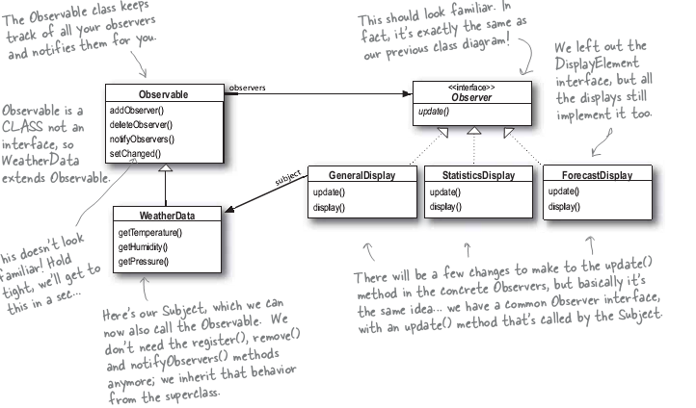
Another Design…

Slide 31
The Java Observer Pattern
For an object to become an observer
Just implement the Observer interface (as before)
For the observable to send notifications
Become observable by extending the java.util.Observable superclass
Call the setChanged() method to signify that the state of the object has changed
Call one of two notification methods:
notifyObservers()
notifyObservers(Object arg)

Slide 32
Notification Revisited
For an observer to receive notifications
Provides a definition of the update method:
update(Observable o, Object arg)
To push data
Pass the data as a data object through the notifyObservers(arg) method
To have the Observer pull data
The Observer must use the Observable object passed to it using the object’s getters and setters
The subject that sent the notification
The data object passed through notifyObservers(arg) (or null)

Slide 33
How to pull
import java.util.Observable;
import java.util.Observer;
public class WeatherData extends Observable{
...;
public weatherData() {}
public void measurementChanged(){
setChanged();
notifyObservers();
}
...;
public float getTempeature(){
return temperature;
}
...;
}

Slide 34
how to pull (pseudo)
setChanged(){
changed = true
}
notifyObservers(Object arg){
if (changed){
for every obsrver on the list {
call update (this, arg)
}
changed = false
}
notifyObservers(){
notifyObservers(null);
}

Slide 35
Rebuilding CurrentConditionsDisplay
public class CurrentConditionsDisplay implements Observer, DisplayElement{
Observable observable;
...;
public CurrentConditionsDisplay(Observable observable){
this.observable = observable;
obserable.addObservable(this);
}
public void update (Observable obs, Object arg){
if (obs instanceof WeatherData){
WeatherData weatherData = (WeatherData) obs;
this.temperature = weatherData.getTemperature();
this.humidity = weatherData.getHumidity();
display();
}
...;
}

Slide 36
The Dark Side of Java Observables
Observable is a class, not an interface
You have to subclass it, so you can’t add the Observable behavior onto a class that already extends something else
Limits reuse potential
Because there’s no Observable interface, you cannot create your own implementations of Observables
Observable protects crucial methods
E.g., setChanged() can only be called by subclasses
Limits flexibilty; you cannot favor composition over inheritance

Slide 37
Observers are Everywhere
Especially in Java Swing
E.g., JButton and associated listeners
Etc.

Slide 38
The Factory Pattern

Slide 39
Creating Objects
…it’s more than just new
A key tenet
Constructor usages often lead to unintended coupling
Remember the note in the Strategy pattern?
When we say “new” to create a new object by calling a constructor, we’re directly programming to an implementation
E.g., Duck duck = new MallardDuck()
We really WANT to use the interface…
But we’re forced to create an instance of a concrete class!

Slide 40
It’s More Complicated than That
Duck duck;
if (picnic){
duck = new MallardDuck();
} else if (hunting) {
duck = new DecoyDuck();
} else if (inBathTub) {
duck = new RubberDuck();
}
… especially when you think about the fact that things might change
E.g., you add a new type of duck and have to figure out when/how to instantiate it
And you make new kinds of Ducks in all different parts of your code

Slide 41
“Open for Extension, Closed for Modification”
A key design goal:
Allow classes to be easily extended to incorporate new behavior
Without modifying existing code
Because everytime you modify it, you risk introducing new bugs
This results in designs that are resilient to change but also flexible enough to accept new functionality to meet changing requirements

Slide 42
Back to Identifying Things that Change
It’d really be nice to use an abstract class here, but, alas, one cannot instantiate an abstract class
Pizza orderPizza() {
Pizza orderPizza(String type) {
Pizza pizza;
if(type.equals(“cheese”)) {
pizza = new CheesePizza();
} else if(type.equals(“greek”)) {
pizza = new GreekPizza();
} else if(type.equals(“pepperoni”) {
pizza = new PepperoniPizza();
}
Pizza pizza = new Pizza();
pizza.prepare();
pizza.bake();
pizza.cut();
pizza.box();
return pizza;
}
These methods can now be specific to a particular type of pizza (i.e., the pizza type knows how to prepare itself) or generic to all pizza types

Slide 43
Change… it’s Coming
The pizza business is a trendy one
Greek pizza is so yesterday…
But with all of the people moving in from CA, we’ve got increasing demands for Veggie pizza. And some weirdos who want clam pizza
What to do?
The orderPizza method is not closed for modification
What varies? What stays the same?
The choices of pizza types change over time
The process (algorithm) for filling an order stays the same

Slide 44
Information Hiding?
What is it we’re supposed to do with the stuff that changes?
Encapsulate it!
Practically, since the thing that’s changing is object creation, we need an object that encapsulates object creation
This object is called a factory
Then the orderPizza method is a client of the factory
Anytime it needs a pizza, it goes to the factory to request that one is created

Slide 45
The Pizza Factory
public class SimplePizzaFactory {
public Pizza createPizza(String type) {
Pizza pizza = null;
if (type.equals(“cheese”)) {
pizza = new CheesePizza();
} else if (type.equals(“pepperoni”) {
pizza = new PepperoniPizza();
} else if (type.equals(“clam”) {
pizza = new ClamPizza();
} else if (type.equals(“veggie”) {
pizza = new VeggiePizza();
}
return pizza;
}
}

Slide 46
Wait, what?
Well, that seems silly. All we did is copy the code out of the orderPizza method, but it still has all of the same problems…
Does it?
The SimplePizzaFactory might have lots of clients (not just the orderPizza method)
That was why we want to encapsulate the thing that changes!
Also, the orderPizza method no longer needs to know anything at all about concrete Pizzas!

Slide 47
Rebuilding PizzaStore
public class PizzaStore {
SimplePizzaFactory factory;
public PizzaStore(SimplePizzaFactory factory){
this.factory = factory;
}
public Pizza orderPizza(String type){
Pizza pizza;
pizza = factory.createPizza(type);
pizza.prepare();
pizza.bake();
pizza.cut();
pizza.box();
return pizza;
}
...;
}

Slide 48
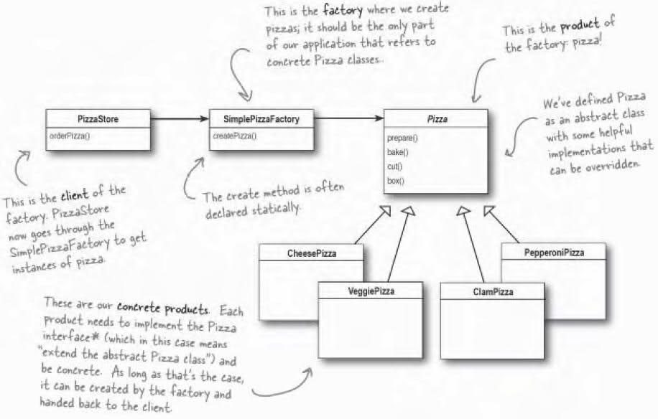
Simple Factory: Not Quite a Pattern
But it is a programming idiom, and it’s commonly used

Slide 49
Franchising the Pizza Store
Now you want to spread your successful business
We want to localize the pizza making activities to the PizzaStore class
For quality control
But we want to give regional franchises the liberty to have their own pizza styles
General framework:
Make the PizzaStore abstract
Put the createPizza method back in PizzaStore, but make it abstract
Create a PizzaStore subclass for every regional type of pizza

Slide 50
The Abstract Method
public abstract class PizzaStore {
public Pizza orderPizza(String type) {
Pizza pizza;
pizza = createPizza(type);
pizza.prepare();
pizza.bake();
pizza.cut();
pizza.box();
return pizza;
}
abstract Pizza createPizza(String type);
}
This is the “factory method”

Slide 51
Delegating to the Subclasses
We’ve perfected the pizza ordering method, and it stays the same across all of the subclasses
But now the regional franchises can differ in the style of pizza they make
E.g., thin crust in New York, thick crust in Chicago
While the orderPizza method looks like it’s defined in the PizzaStore class, this class is abstract
It can’t actually do anything
So when it is executed, it is actually executing in the context of a concrete subclass
This context gets determined when the (abstract) method createPizza gets called

Slide 52
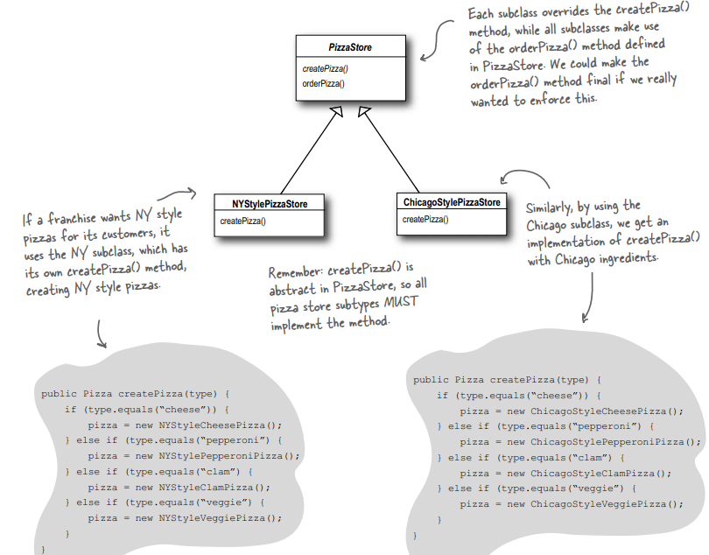
Delegating to the Subclasses (cont.)

Slide 53
What does a Franchise Look Like?
Bonus. The franchises get all of the benefits of the perfected PizzaStore ordering process
All they have to do is define how to create pizzas!
public class NYPizzaStore extends PizzaStore {
Pizza createPizza(String item) {
if (type.equals(“cheese”)) {
return new NYStyleCheesePizza();
} else if (type.equals(“pepperoni”) {
return new NYStylePepperoniPizza();
} else if (type.equals(“clam”) {
return new NYStyleClamPizza();
} else if (type.equals(“veggie”) {
return new NYStyleVeggiePizza();
} else return null;
}
}

Slide 54
A Generic Factory Method
abstract Product factoryMethod(String type)
The factory method isolates the client (the code in the superclass) from knowing what kind of concrete Product is created
A factory method is abstract so the subclasses are counted on to handle object creation
A factory method returns a Product that is typically used within methods defined in the superclass
A factory method may be parameterized (or not) to select among several variations of a Product

Slide 55
Ordering a Pizza
What happens when a customer wants to order a pizza?
Write down the sequence of steps involved in a customer ordering a NY style (thin crust) cheese pizza.

Slide 56
Solution
First, the customer needs to get a NY PizzaStore:
PizzaStore nyPizzaStore = new NYPizzaStore();
Now the pizza store can accept our order
nyPizzaStore.orderPizza(“cheese”);
The orderPizza method calls the createPizza method
Pizza pizza = createPizza(“cheese”);
Remember the createPizza method is implemented in the subclass, so we’re automagically getting a NY style cheese pizza here
The orderPizza method finishes preparing our pizza
pizza.prepare();pizza.bake();pizza.cut();pizza.box();
These methods are defined in the abstract PizzaStore class, which doesn’t need to know which kind of pizza it is in order to follow the steps

Slide 57
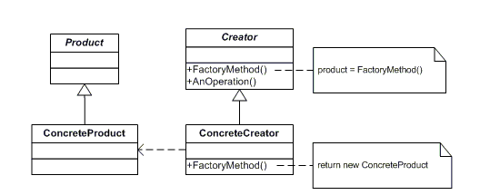
The Entire Solution
The whole thing requires some pizzas to tie everything together; you can check out the sample source code to see how it all fits
Parallel Class Hierarchies

Slide 58
The Factory Method Pattern
The Factory Method Pattern defines an interface for creating an object but lets subclasses decide which class to instantiate. Factory Method lets a class defer instantiation to subclasses

Slide 59
Our “Dumb” Pizza Store Revisited
Imagine going back to the beginning and creating a PizzaStore that amassed all of the decision making
Inside the createPizza method of this pizza store, I would just have a huge, nested set of if statements to determine which style of pizza and then which type of pizza to create

Slide 60
The intuitive way of design
public class DependentPizzaStore{
public Pizza createPizza (String style, String type){
Pizza pizza = null;
if (style.euqals(“NY”)){
if (type.equals(“cheese”)){
pizza = new NYStyleCheesePizza();
} else if (type.equals(“veggie”)){
pizza = new NYStyleVeggiePizza();
} else if (type.equals(“clam”)){
pizza = new NYStyleClamPizza();
} else if (type.equals(“pepperoni”)){
pizza = new NYStylePepperoniPizza();
}
} else if (style.equals(“Chicago”)){
...;
}
pizza.prepare();
pizza.bake();
...;
return pizza;
}
}

Slide 61
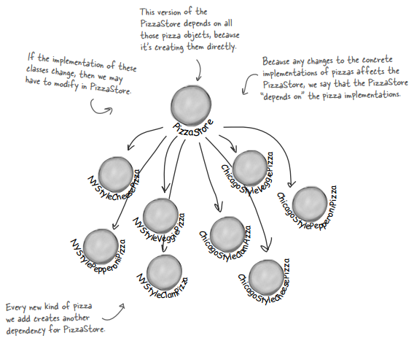
What does this Look Like?

Slide 62
Another Design Principle
This seems like a bad idea. We’re definitely not encapsulating for change.
If we change any of the concrete pizza classes, we have to change the PizzaStore because it depends on them
Instead we should depend upon abstractions. Do not depend upon concrete classes
High level components should not depend on low-level components; instead, both should depend on abstractions
For example, in the previous pizza store, the store depended on all of the pizza types
Instead, the pizza store should depend on the abstract notion of Pizza, and the concrete pizza types should too
This is exactly what the Factory Method pattern we applied did!

Slide 63
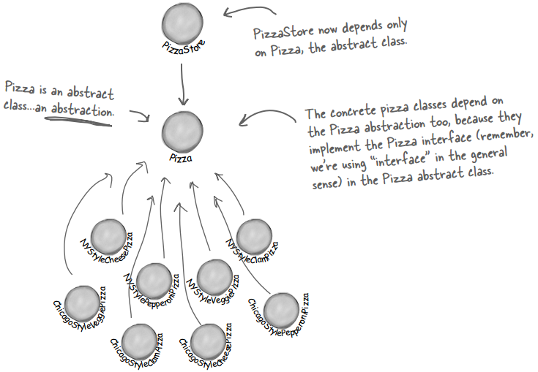
Dependency Inversion

Slide 64
Guidelines that Help
NOT RULES TO FOLLOW
No variable should hold a reference to a concrete class
If you use new, you’ll be holding a reference to a concrete class
Use a factory to get around that!
No class should derive from a concrete class
If you do, you’re depending on the concrete class
Instead, derive from an abstraction (like an interface or an abstract class)
No method should override an implemented method of any of its base classes
If you do, then your base class wasn’t really an abstraction
The methods implemented in the base class are meant to be shared by the derived classes

Slide 65
The Abstract Factory

Slide 66
Controlling Pizza Quality
Some of your franchises have gone rogue and are substituting inferior ingredients to increase their per-pizza profit
Time to enter the pizza ingredient business
You’ll make all the ingredients yourself and ship them to your franchises
But this is not so easy…
You have the same product families (e.g., dough, sauce, cheese, veggies, meats, etc.) but different implementations (e.g., thin vs. thick or mozzarella vs. reggiano) based on region

Slide 67
The Ingredient Factory Interface
public interface PizzaIngredientFactory {
public Dough createDough();
public Sauce createSuace();
public Cheese createCheese();
public Veggies[] createVeggies();
public Pepperoni createPepperoni();
public Clams createClams();
}

Slide 68
Then What?
For each region, create a subclass of the PizzaIngredientFactory that implements the concrete methods
Implement a set of ingredients to be used with the factory (e.g., ReggianoCheese, RedPeppers, ThickCrustDough)
These can be shared among regions if appropriate
Integrate these new ingredient factories into the PizzaStore code

Slide 69
The New York Ingredient Factory
public class NYPizzaIngredientFactory implements PizzaIngredientFactory {
public Dough createDough() {
return new ThinCrustDough();
}
public Sauce createSauce() {
return new MarinaraSauce();
}
public Cheese createCheese() {
return new ReggianoCheese();
}
public Veggies[] createVeggies() {
Veggies veggies[] = {new Garlic(), new Onion(), new Mushroom(), new RedPepper()};
return veggies;
}
public Pepperoni createPepperoni() {
return new SlicedPepperoni();
}
public Clams createClam() {
return new FreshClams();
}
}

Slide 70
Connecting to the Pizzas
Now, we need to force our franchise owners to only use factory produced ingredients
Before, the abstract Pizza class just had Strings to name its ingredients
It implemented the prepare() method (and bake(), cut(), and box())
The concrete Pizza classes just defined the constructor which, in some cases, specialized the ingredients (and sometimes cut corners) and maybe overwrote other methods
Now, the abstract Pizza class has actual ingredient objects
And the prepare() method is abstract
The concrete pizza classes will collect the ingredients from the factories to prepare the pizza

Slide 71
Concrete Pizzas
Now, we only need one CheesePizza class (before we had a ChicagoCheesePizza and a NYCheesePizza)
When we create a CheesePizza, we pass it an IngredientFactory, which will provide the (regional) ingredients

Slide 72
An Example Pizza
public class CheesePizza extends Pizza {
PizzaIngredientFactory ingredientFactory;
public CheesePizza(PizzaIngredientFactory ingredientFactory){
this.ingredientFactory = ingredientFactory;
}
void prepare() {
System.out.println("Preparing " + name);
dough = ingredientFactory.createDough();
sauce = ingredientFactory.createSauce();
cheese = ingredientFactory.createCheese();
}
}
Which cheese is created is determined at run time by the factory passed at object creation time

Slide 73
Fixing the Pizza Stores
public class NYPizzaStore extends PizzaStore {
protected Pizza createPizza(String item) {
Pizza pizza = null;
PizzaIngredientFactory ingredientFactory = new NYPizzaIngredientFactory();
if (item.equals("cheese")) {
pizza = new CheesePizza(ingredientFactory);
pizza.setName("New York Style Cheese Pizza");
} else if (item.equals("veggie")) {
pizza = new VeggiePizza(ingredientFactory);
pizza.setName("New York Style Veggie Pizza");
} // more of the same…
return pizza;
}
}
For each type of pizza, we instantiate a new pizza and give it the factory it needs to get its ingredients

Slide 74
Whew. Recap.
We provided a means of creating a family of ingredients for pizzas by introducing a new type of factory: the abstract factory
An abstract factory provides an interface for creating a family of products
Decouples code from the actual factory that creates the products
Makes it easy to implement a variety of factories that produce products for different contexts (we used regions, but it could just as easily be different operating systems, or different “look and feels”)
We can substitute different factories to get different behaviors

Slide 75
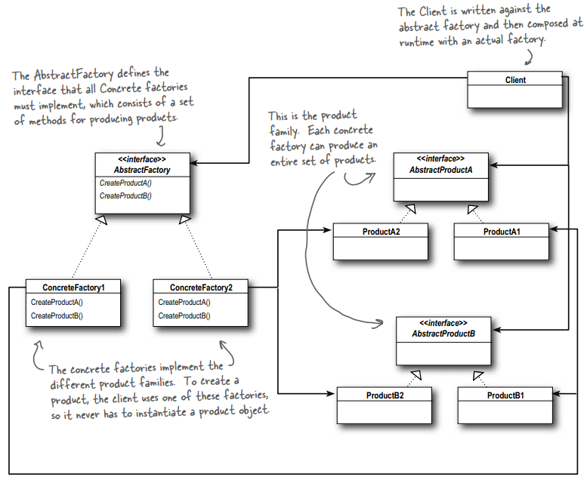

Slide 76
The Abstract Factory Pattern
The Abstract Factory Pattern provides an interface for creating families of related or dependent objects without specifying their concrete classes.

Slide 77
Factory Method vs. Abstract Factory
Decouples applications from specific implementations
Creates objects through inheritance
Create objects by extending a class and overriding a factory method
Useful if you don’t know ahead of time what concrete classes will be needed
Decouples applications from specific implementations
Creates objects through object composition
Create objects by providing an abstract type for a family of products
Subclasses define how products are produced
Interface must change if new products are added

Slide 78
Questions?

